Slide 1

Nosferatu
We will Hash Slinging Slash your electric bill
By: Gunnar Boehm, Dan Cardin, Joe Gorse, Connor Igo, Chris Holtsnider,
Advisor: John Kimani
2015 EECE Capstone

Slide 2
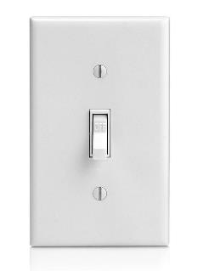
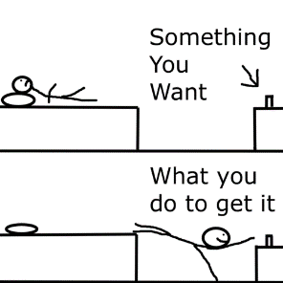
The Problem
Forgetting to turn your lights off when you leave your house
Needing to get out of your comfortable bed to turn off lights
Bumping into furniture on your way to the bathroom late at night

Slide 3
Introduction
Nosferatu is an energy efficient, convenient new way to control your home lighting. Bringing Wi-Fi and motion sensors to your light switches allows you to set schedules and rules to manage your home lighting, as well as save money, energy and time.

Slide 4
Uses
Walk into a room, motion sensor turns light on automatically
With rules you can set a switch to not respond to motion at certain times of day
Going away on vacation, can set a schedule to turn on some house lights to deter robbers
Turn off/on a light from your computer or phone anywhere
In bed
At work
At Conor Larkins
Save on your electric bill by having your lights turn off after time intervals or certain times of day

Slide 5
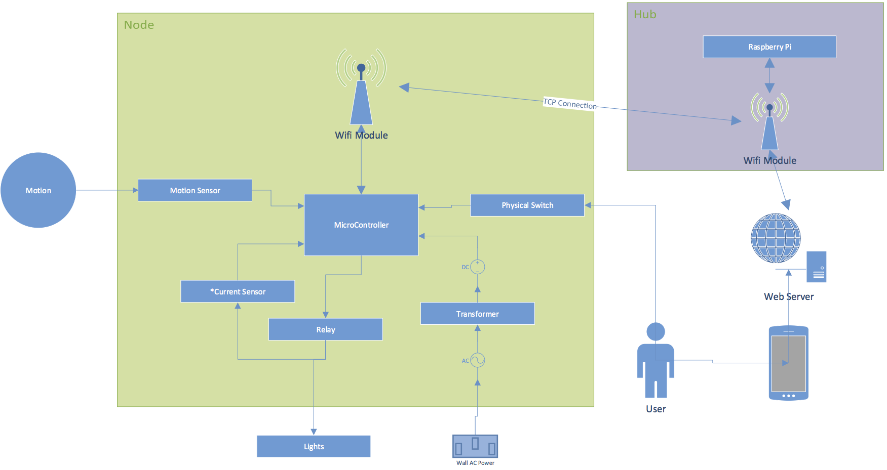
Hardware Layout
Notes:
Need to update this chart: Server is on Rpi, not external. Joe doesn’t have Visio so can someone else do that?

Slide 6
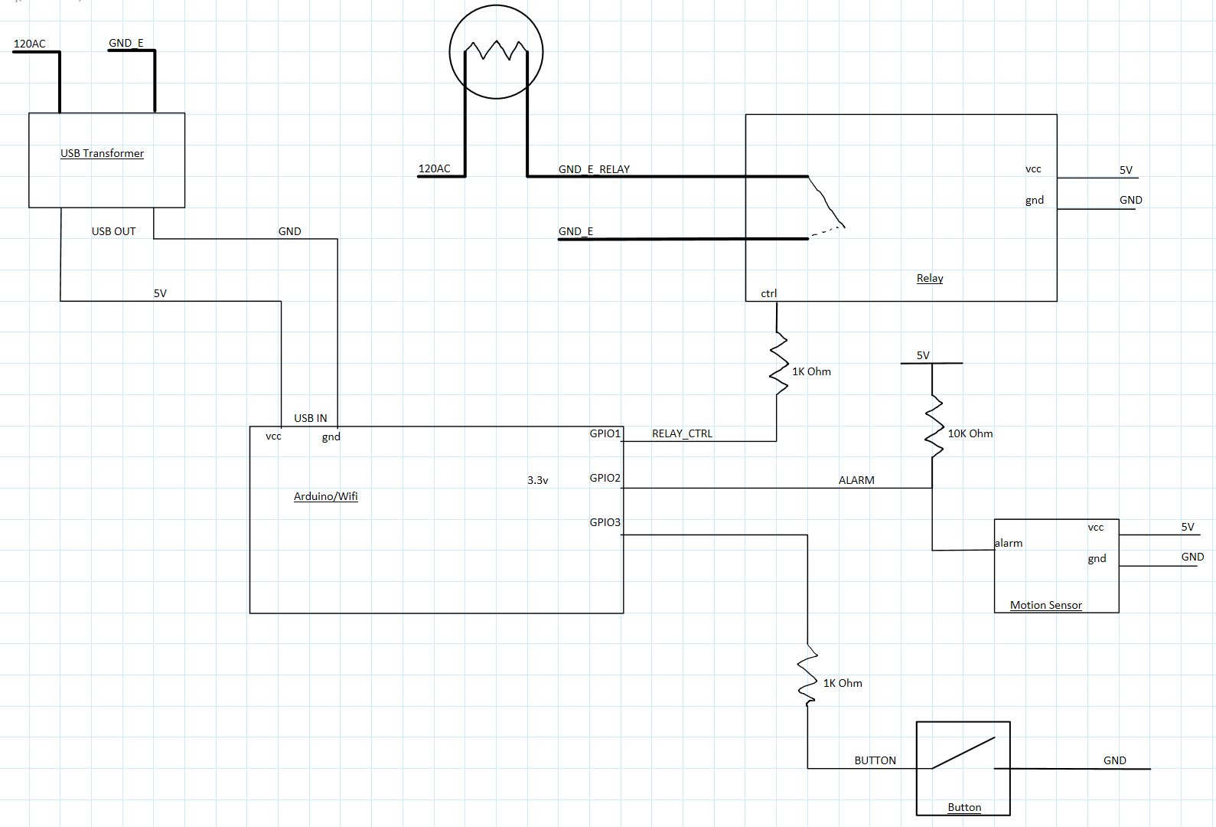
Hardware Schematic

Slide 7
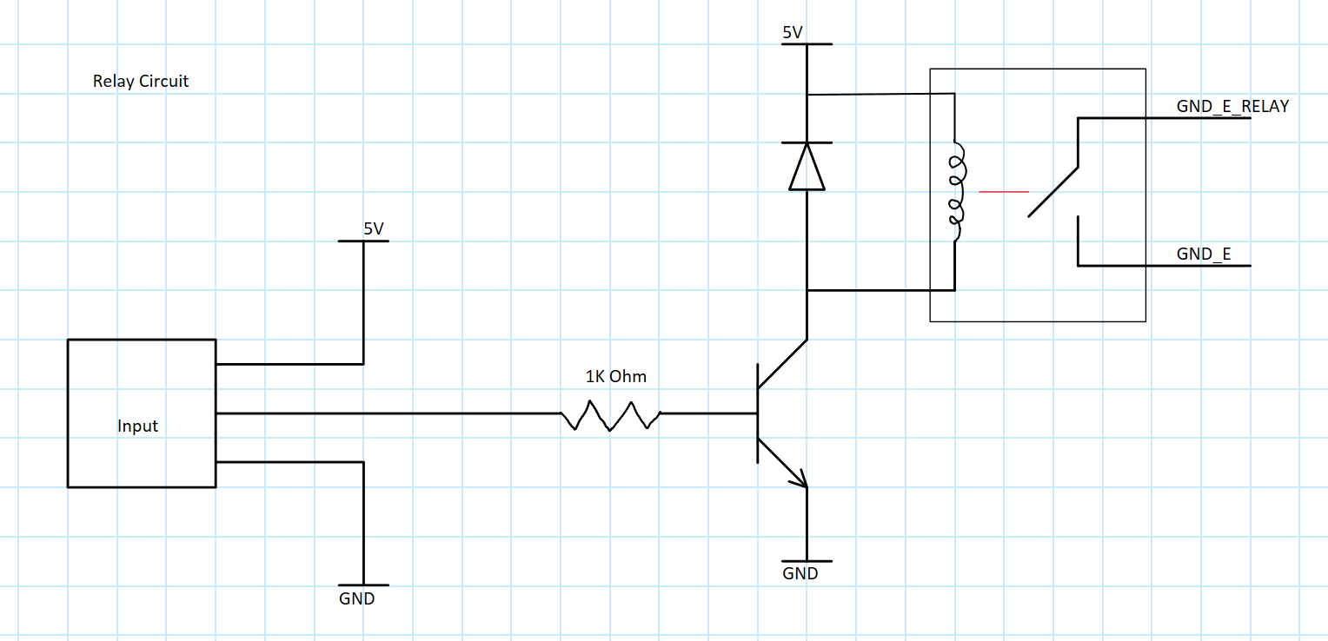
Relay Schematic

Slide 8
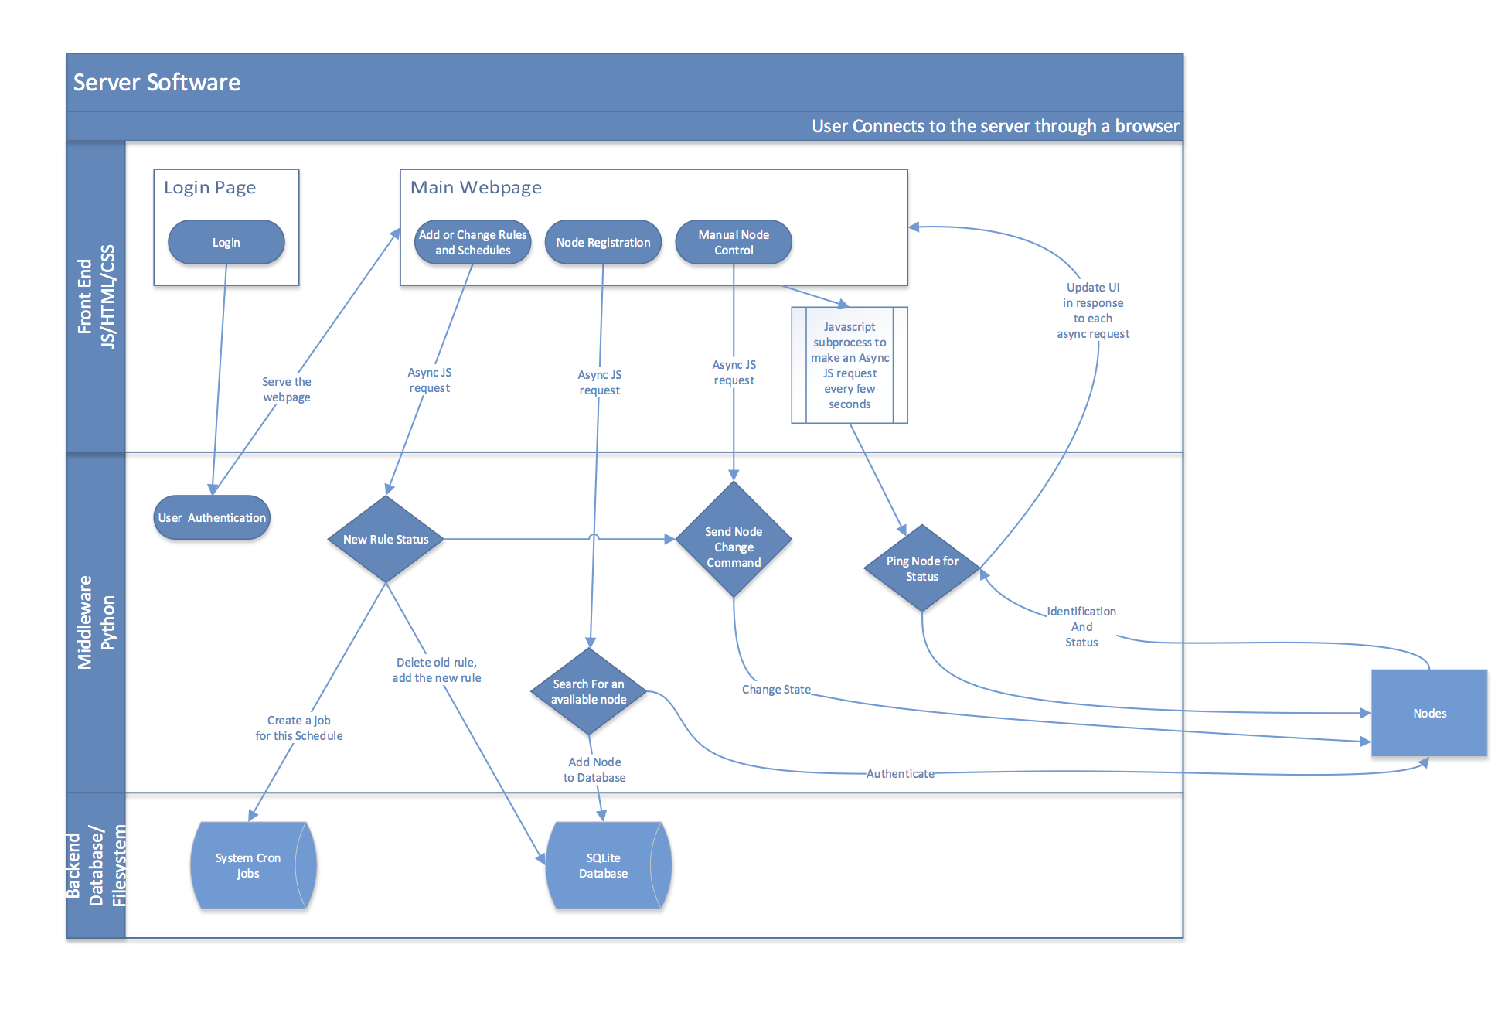
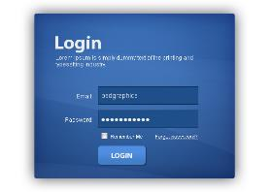

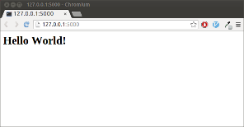
Software Layout
Coffeescript (JS is the worst)
Angular
Ajax
Python
Gunicorn
SQLAlchemy
Celery
PostgreSQL
Notes:
Need to update this:
Updated screenshot to replace hello world
Updated login screenshot
Update frameworks used
Update software flowchart (mostly the backend)

Slide 9
Build Process
Notes:
Need to add some pictures of the project- Rpi, node fully set up, maybe screenshots of web UI?

Slide 10
What makes Nosferatu special
Compared to Wi-Fi lightbulbs
Don’t need to replace an expensive lightbulb whenever it dies
More sophisticated and synchronized system/setup
Compared to similar switches (such as the Belkin WeMo)
Motion Sensor
Rules
Web API
Cheaper

Slide 11
Conclusion
Nosferatu is cheaper than the competition
Nosferatu is easier to use
Nosferatu is the most convenient way to manage your home lighting
Thank you to our advisor, John Kimani, for your guidance and support

Slide 12
Questions?

